Slide 1


Computer Vision Project-Face Recognition
Pankaj Bhatia
Palash Patel
Jeevan Jot Singh
Sunil Kumar

Slide 2



Agenda
Project Description
Data Description
Objective
Steps and Tasks
Results

Slide 3




What is Face recognition?
Introduction
Facial recognition is a category of biometric software that maps an individual's facial features mathematically and stores the data as a face print. The software uses deep learning algorithms to compare a live capture or digital image to the stored face print in order to verify an individual's identity.

Slide 4
Face Detection vs. Face Recognition
Though they sound similar, the complexity involved in both is vastly different. In Face Detection, the computer recognizes the face within an image and locates its position. If you have used face changer app on Snapchat, you are using face detection. Face recognition deals with identification to establish whose face it is by matching it to an existing face database. You can refer to the images below for the distinction.

Slide 5
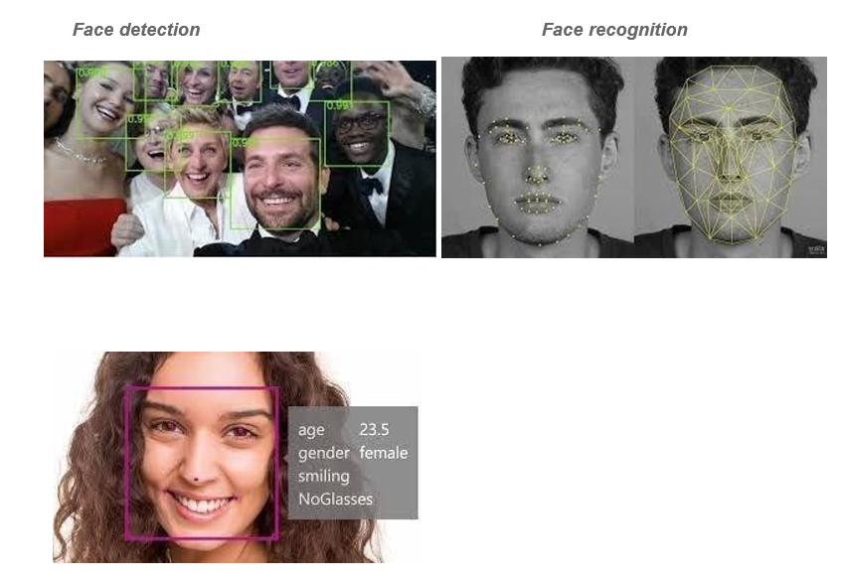
Face Detection Vs Recognition
Apart from identification, other typical features are ● Emotion Detection ● Age Detection ● Gender Detection ● Attention Measurement ● Sentiment Detection ● Ethnicity Detection

Slide 6
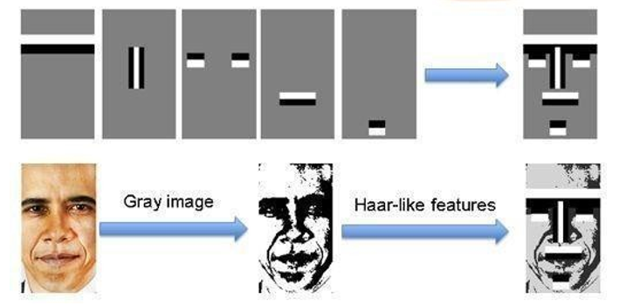
How Does Face Recognition Work?
There are two approaches to the facial recognition:
Feature-Based Face Recognition and
Appearance-Based Face Recognition
Haar-like features are the rectangle which is divided into different rectangles.
First, the image is grayscale, then the haar-like features (rectangle) are shifted through the image, comparing similar image rectangles with Haar-like features, similar ones are marked.

Slide 7
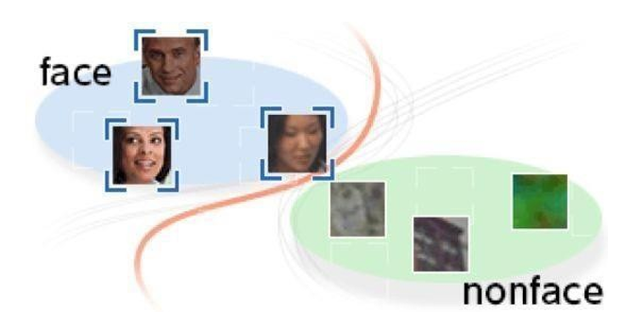
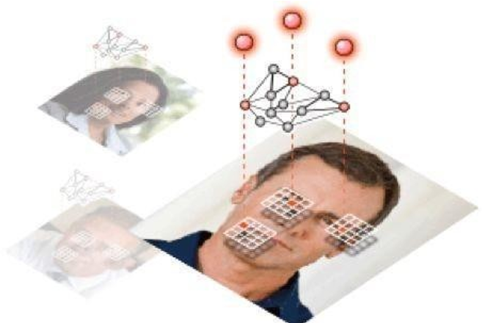
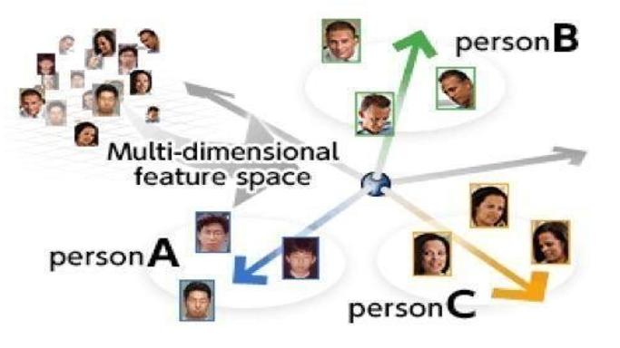
How Does Face Recognition Work?
The following are three main steps in the face recognition using haar-like method: Step
Detects the “position of the face”
Step 2. Finds the “feature of the face”
Step 3. Search and identify of the “detected face” in the database.

Slide 8
Aligned Face Dataset from Pinterest
DATA DESCRIPTION
This dataset contains 10.770 images for 100 people. All images are taken from 'Pinterest’ and is aligned using Dlib library which is used to estimate the location of 68 coordinates (x, y) that map the facial points on a person's face
In this problem, we use a model trained on Face recognition to recognize similar faces. Here, we are particularly interested in recognizing whether two given face are of the same person or not.

Slide 9
Aligned Face Dataset from Pinterest
Load the dataset and create the metadata.
Check some samples of metadata.
Load the pre-trained model and weights.
Generate Embedding vectors for each face in the dataset.
Build distance metrics for identifying the distance between two given images.
Use PCA for dimensionality reduction.
Build SVM classifier to map each image to its right person.
Predict using the SVM model.

Slide 10
Libraries Used
OS
NumPy
CV2
TensorFlow
Keras
Matplotlib

Slide 11
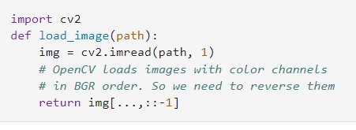
Reading image from Zip file

Slide 12
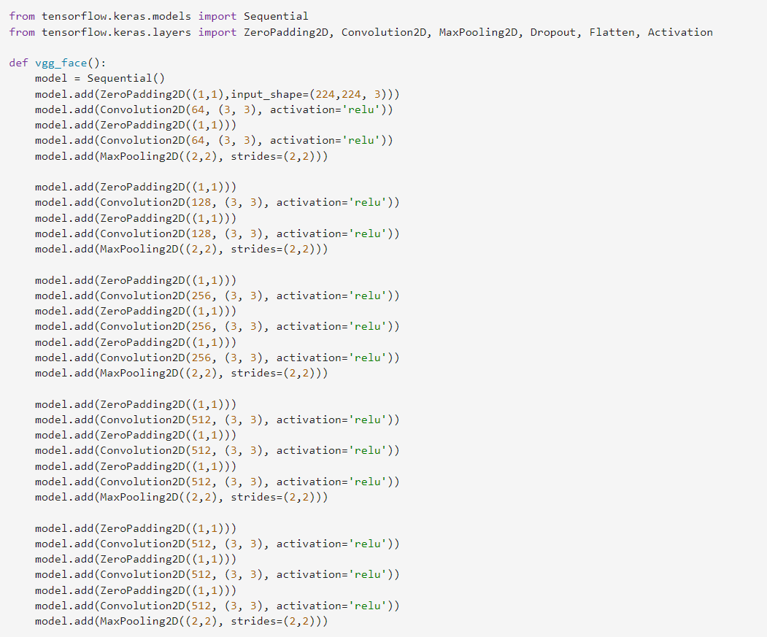
VGG Face Model
VGG-Face model uses the Sequential API from TensorFlow's Keras module.
It creates a Convolutional Neural Network model with multiple layers of Convolution2D and MaxPooling2D.
The model input shape is (224,224,3) and it uses the ‘Relu' activation function for all Convolution2D layers except the last one, which doesn't have an activation function.
The model is then compiled with a ‘Softmax’ activation function for classification and a categorical cross-entropy loss function.

Slide 13
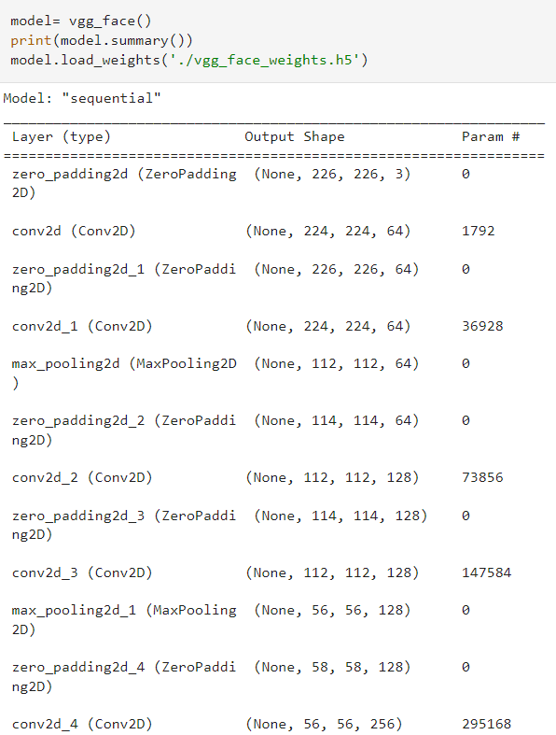
Loading The Model
It loads a VGG- Face Model using the vgg_face() function.
Prints the summary of model architecture using the summary ()method.
And then loads the pre-trained model weights from the file vgg_face_weight.h5

Slide 14
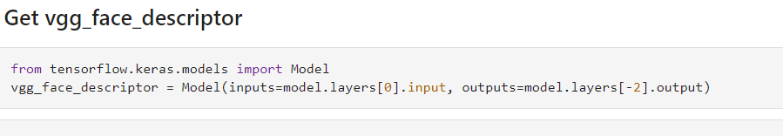
VGG Face Descriptor
In the code, we are using the Keras library in TensorFlow to create a Model object and define a vgg_face_descriptor . The Model object is used to create a new model based on an existing model by specifying the input and output layers for the new model.
By passing these inputs and outputs to the Model constructor, a new model with the same input layer and the output layer just before the last one can be created. This new model is then assigned to the vgg_face_descriptor variable.

Slide 15
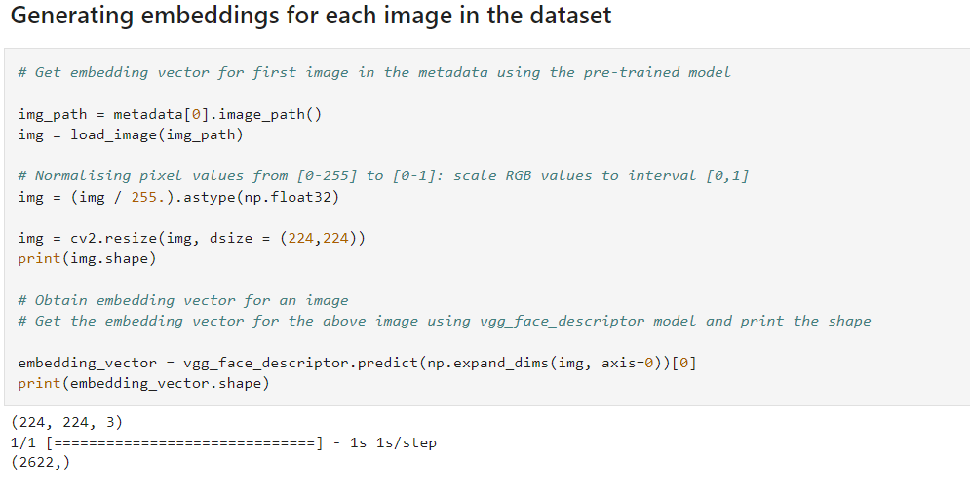
Embedding Vector
Subtitle
Subtitle

Slide 16
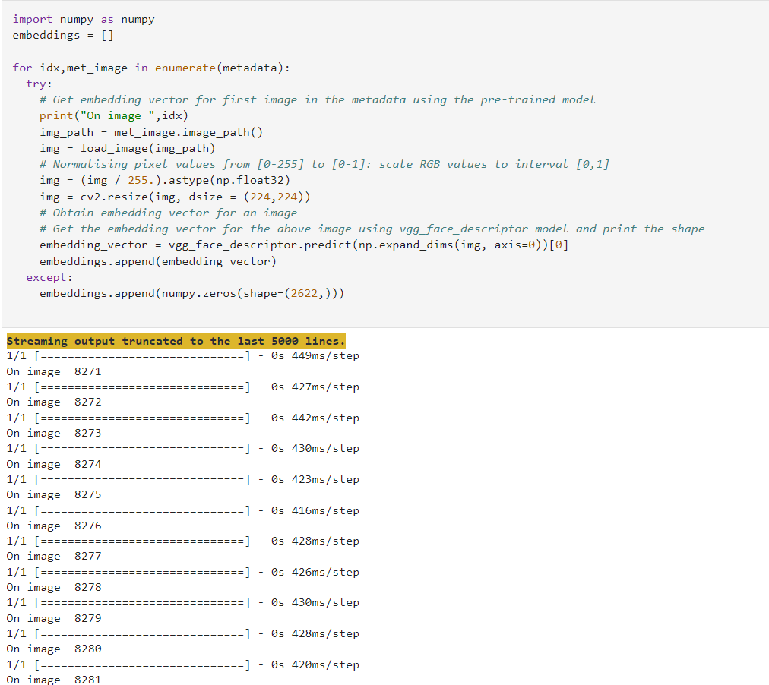
Face recognition Using a pre-trained model

Slide 17
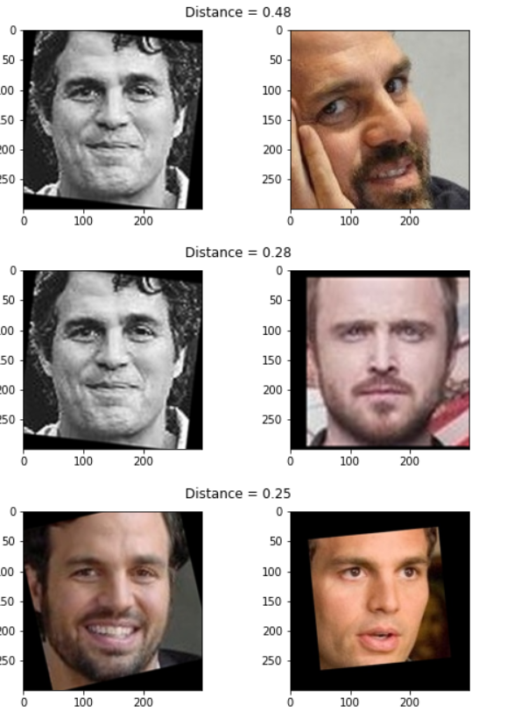
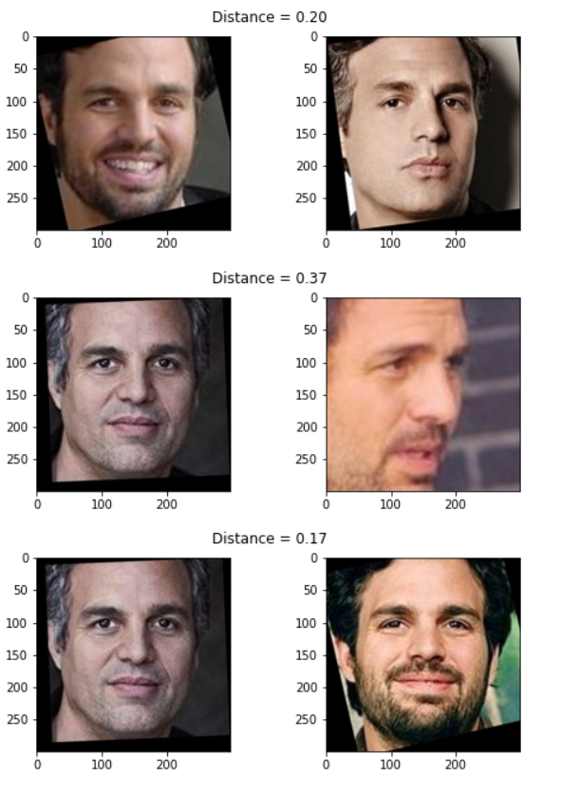
Plotting of images
Distance B/w the pairs

Slide 18
Train and Test Sets
Creating X_train, X_test and y_train, y_test
Use train_idx to seperate out training features and labels
Use test_idx to seperate out testing features and labels

Slide 19
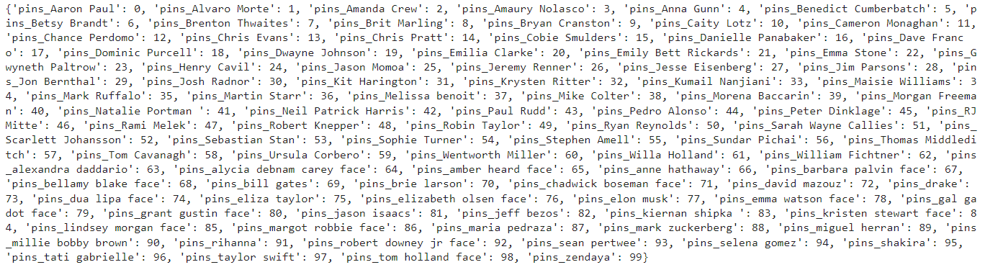
Encode the labels
Label encoding is a technique used to convert categorical data into numerical data so that it can be used in machine learning models.

Slide 20
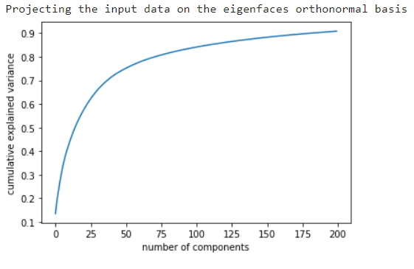
PCA
The PCA class was used to fit the dataset and transform it using principle components
The svd-solver parameter sets the algorithm to use for the decomposition of the data

Slide 21
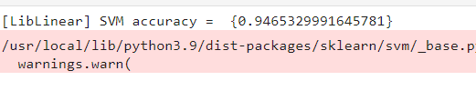
SVM
Use SVM Classifier to predict the person in the given image
Fit the classifier and print the score
ACCURACY

Slide 22
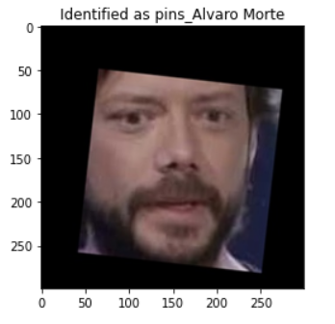
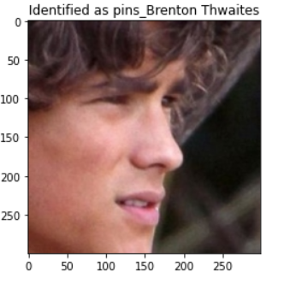
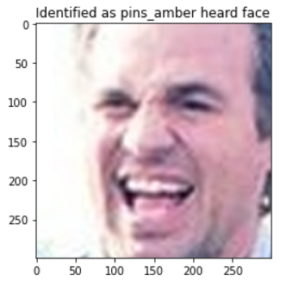
Result

Slide 23

Contributors
Sunil & Palash: Finding the topic and performing all the due diligence on the dataset, finding the resources and designing the pathway for step-by-step process to reach the goals.
Pankaj & Jeevan: Worked on the coding aspects and performing error checks at every possible steps.
All the team-members collectively worked on framing the structure and workflow of the project to shape it

Slide 24


Thank You
Presenter name:
Pankaj Bhatia
Jeevan Jot Singh
Palash Patel
Sunil Kumar

